Slide 1
Preparing for the New Standards and Assessments
1. Backwards Design
2. Pacing Guides reflecting Standards that can be Organized into Units

Slide 2
Stages of Backward Design Process
Stage 1: Identify desired results
Stage 2:
Determine acceptable evidence.
Stage 3:
Plan learning experiences & instruction.

Slide 3
Stage 1: Identify desired results
Identify what students should know, understand, and be able to do.
This should reflect course goals and content standards.
Worth Being
Familiar With
Important
to know
and do
“Enduring”
Understanding
Notes:
Perhaps looking at the Learning Progressions can help you determine “Enduring Understanding” because it shows how standards build on each other.
Learning progression for Science, Social Studies, Math and ELA can be found on the ODE website.

Slide 4
Stage 2: Determine acceptable evidence
What evidence will show that students understand?
Use FIP and Assessment Literacy strategies for designing quality assessments:
(Selected Response, Constructed Response and Performance)
Other Evidence (e.g., observations, work samples, dialogues)
Notes:
EXAMPLES
Selected Responses: multiple choice, matching, true/false
Constructed Response: short answer, extended response, essay
Performance: product, visual, verbal & physical

Slide 5
Stage 3: Planning Experiences & Instruction
Create lesson plans to reflect established priorities.
Focus on engaging and effective learning
Develop learning experiences and instruction to promote the desired understanding, knowledge and skill of Stage 1. (desired results)
Focus instructional design to ensure students are maximally engaged and effectively meeting the goals.
Notes:
STAGE 3 –
This is the final stage of the process. What activities, resources and experience will you plan to achieve the desired results.

Slide 6
Why use an Essential Question?
Signals that inquiry is a key goal of education.
Makes it more likely that the unit will be intellectually engaging
Helps to clarify and prioritize standards
Provides transparency for students
Encourages a model of Metacognition for students
Provides opportunities for intra- and interdisciplinary connections
Supports meaningful differentiation
Notes:
When Creating Stage 3, it will be helpful to design essential questions in your pacing and planning.

Slide 7
Defining Characteristics of Essential Questions
causes genuine and relevant inquiry into the big ideas/themes and core content;
provokes deep thought, lively discussion, sustained inquiry, and new understanding;
requires students to weigh evidence, support their ideas, and justify their answers;
sparks meaningful connections with prior learning and personal experiences;
naturally recurs, creating opportunities for transfer to other situations and subjects.
Notes:
Here are the defining Characteristics of Essential Questions READ
Don’t worry about this aspect yet. This is something that we will have more discussion around and really is a final step in the unite process.

Slide 8
So how does this look when we plan for our students?
Look at standard(s) you have identified in you instructional unit/theme/big idea
Make a list of the skills, concepts, and knowledge kids need to learn.
Next, design the final assessment/project where students will demonstrate understanding toward mastery of these skills, concepts, knowledge.
Then, create a set of lessons that lead up to that end.
Once you've done this, reflect on the set of lessons, making sure all the skills, concepts, and knowledge for student success are there with the end in mind.
Notes:
To sum up backward Design – these are the steps necessary for planning with the end in mind

Slide 9
Pacing Guides as a fluid document
Google Doc Pacing Guides
Fluid Documents that grow and change to reflect student needs
Standards are organized into units/big ideas.
Notes:
The ultimate goal is to have a shared pacing guide that everyone in your building can view; therefore, Google Docs is the best platform to begin a pacing guide.
By using Google Docs, any updates that are made will be “live”.
If you teach multiple subjects, pick one area to begin your Google Docs Pacing. Example: Elementary ELA –
Finally, your guide should be unit or theme designed around the new Learning Standards.

Slide 10
Expectations
Weekly? Monthly? Quarterly?
Learning Target Aligned to the Standards (skill-based)
Instructional Resources
Assessments
Blooms and/or Webbs DOK
Essential Question(s)
Other Areas to Consider
Activity Summary
Content/Theme
Textbook/Materials Alignment
Vocabulary
Notes:
First, teachers and teams can decide the best way to organize their pacing for their use – Weekly – Monthly or Quarterly
But……..Here are the items that we should see on the guides.
This is not something that needs to be completed tomorrow or even next month.
REMEMBER, this should be a fluid document that grows and changes as you evaluate resources and assessments
AND….. You will have all of the May Professional Development day to continue the work.
We would like to see a framework of your pacing guide by the end of the school year. (1st Quarter online)
If you already have a Pacing guide – Take a look at how you can reorganize and add to your current document to meet the required elements.
STANDARDS are the bases for all of our assessments.
To see growth in all students we need to focus on teaching and tracking student progress toward the standards.
A well organized pacing guide will be your best tool for this process.

Slide 11
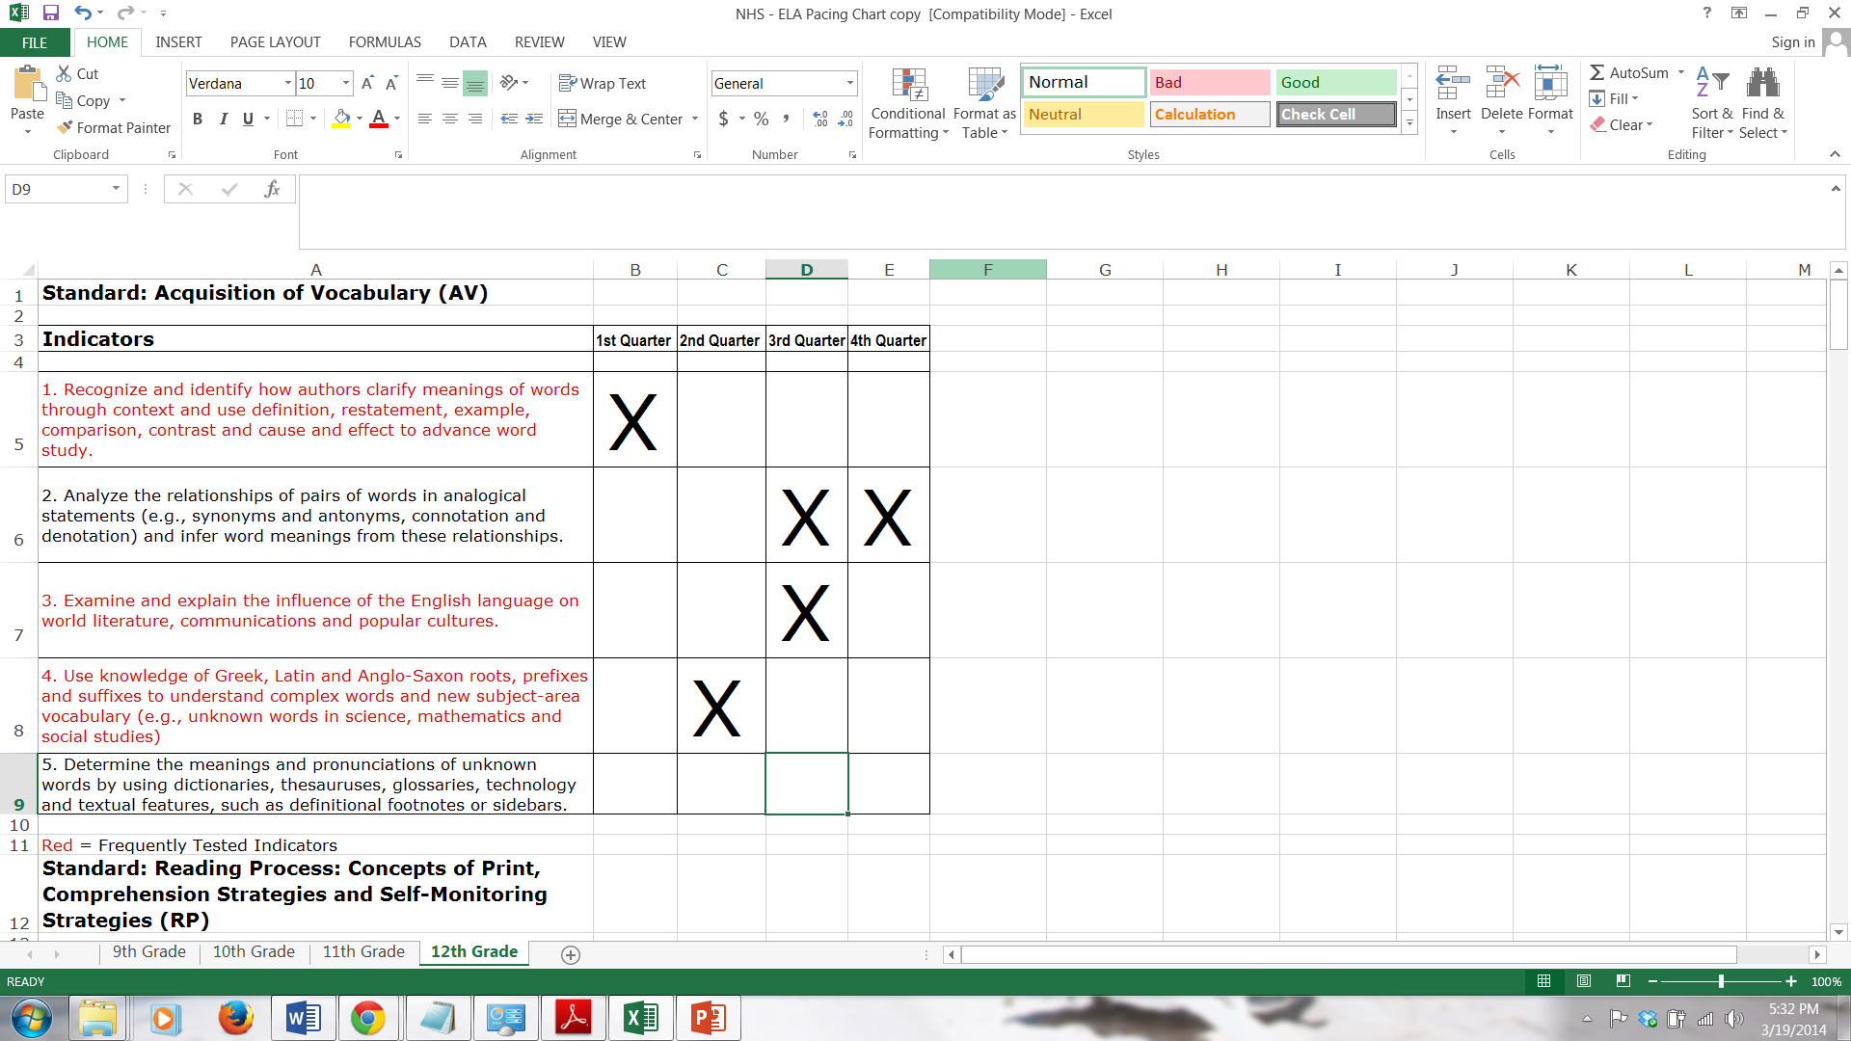
Notes:
Here is an example of our former pacing guides. Basically they were used to make sure all the standards were covered.

Slide 12
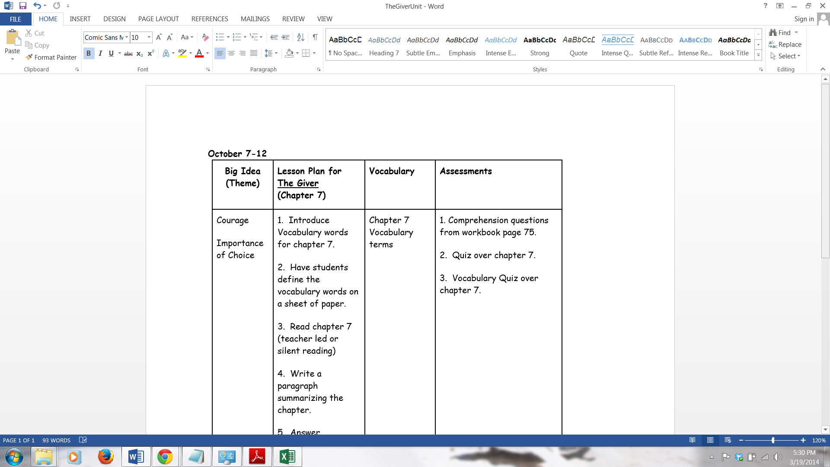
Notes:
Here’s another “Thematic Unit” that we might be familiar using as well.
Was it created with the end in mind? Probably not.
Can this pacing guide be reorganized into a skills-based unit so the text is a resource? Absolutely!
What is it missing?
Skill-based, Standards, Authentic Assessment, overall it is missing a purpose.
It talks about a big idea, but that idea is NOT addressed.

Slide 13
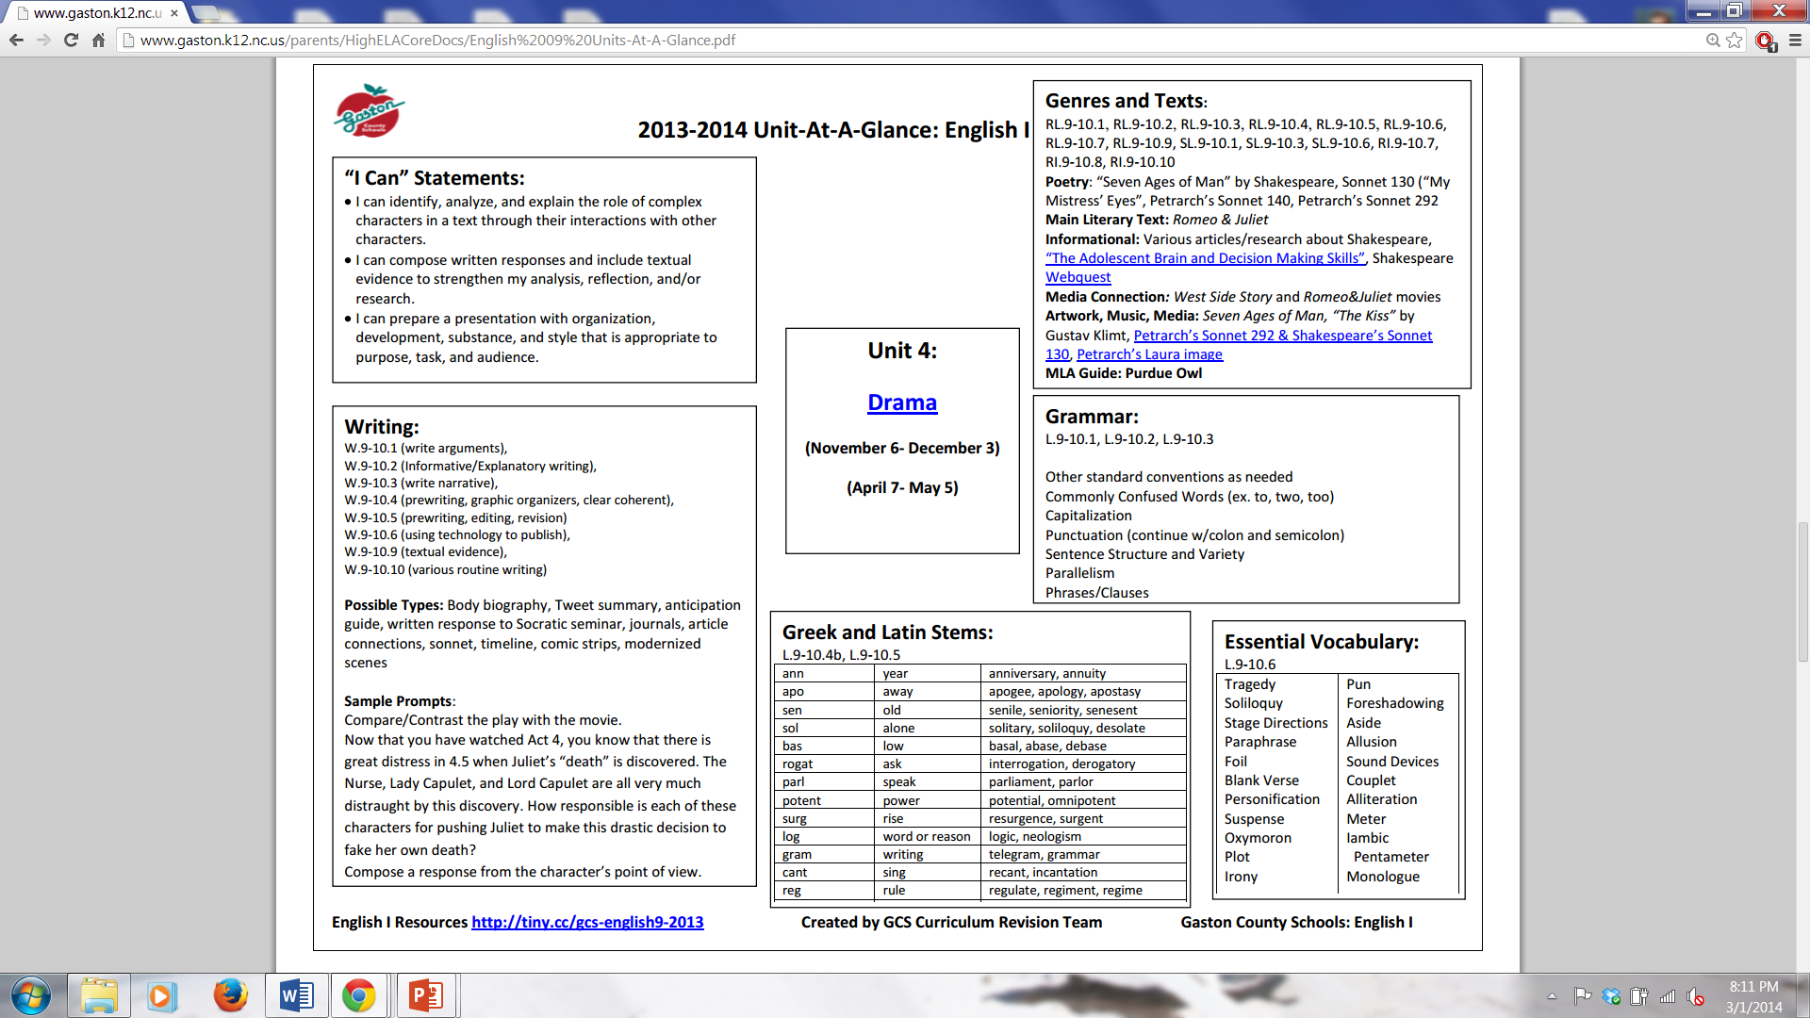
Notes:
Be careful - There are lots of pacing guide and units out there on the Web to look at as you begin refining your document
Here is an English 9 (Unit as a glance) This is an example of something that is too broad.
It is not really a pacing guide.

Slide 14
2nd grade ELA – links to Science and Social Studies
Notes:
Here is another example of a great tool that is NOT really a pacing guide but a map or weekly summery for a second grade team.
Great Idea, but not really a pacing guide.
Lets look at some examples of Pacing Guides created with the end in mind,

Slide 15
Pacing by Month
Pacing by Quarter
Notes:
This example, as well as the next few we will look at touch on the majority of the guidelines that we would like to see in our pacing guides at Northridge.
This one is from the New York Department of Education – It demonstrates Pacing by quarter
It is difficult to read on the PowerPoint, but certainly touches on all of the important parts of a pacing guide
Standards, Essential question, content, skills, Instructional Resources and Assessment

Slide 16
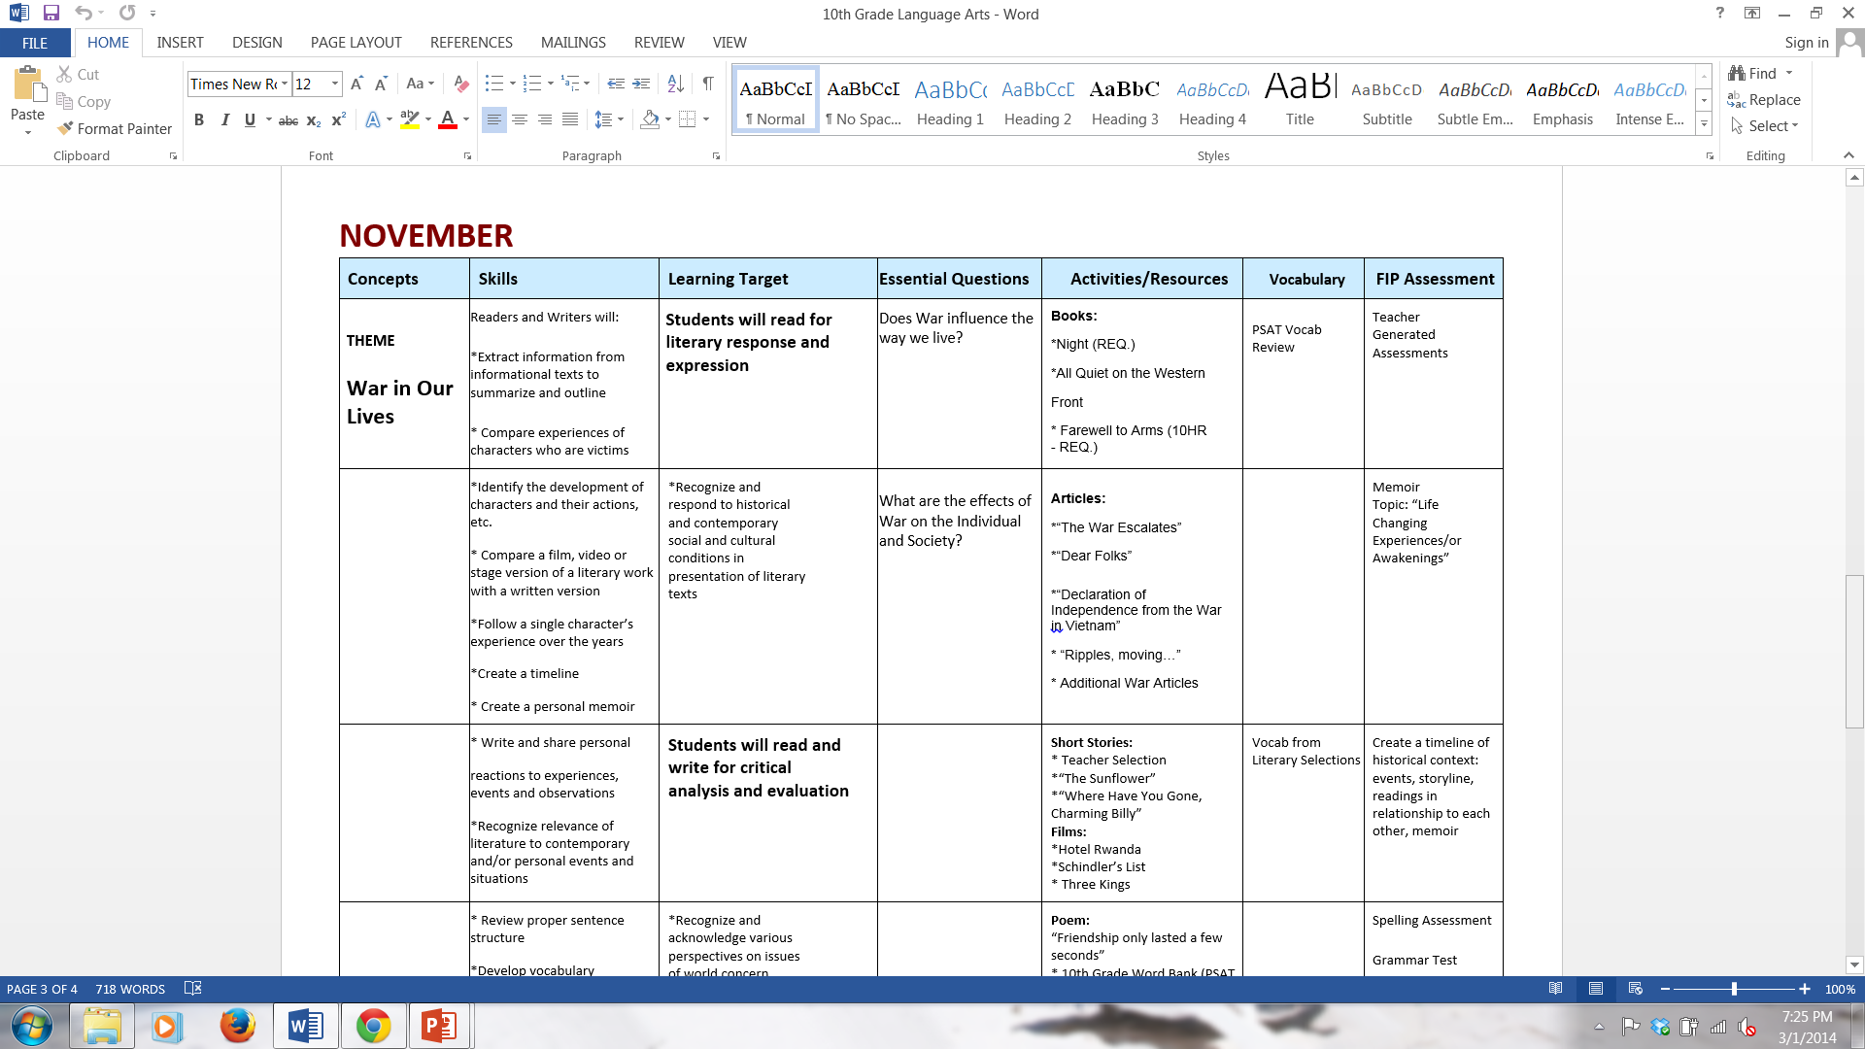
Add EDMS Example
Pacing by Month
Notes:
Here is an example of a Pacing Guide by Month (this is a 10th Grade ELA pacing guide)
You can see that it focuses on a Theme (War in our Lives) and there are 2 essential questions surrounding the theme:
Does war influence the way we live? AND What are the effects of WAR on the individual and society?
It looks like this unit may have been planned with the Social Studies teacher which is another way of immersing students into a topic between classes.
The Skills on this pacing align with the standards, but it would be nice to see the Standard listed .

Slide 17
Pacing by Week
Notes:
Here is an example of our own Timberlane’s Language Arts Pacing guide
They have worked on this for quite some time and will now take a look at the themes they are covering and design Essential Questions for students.
This Pacing is by Week and ALL 8 teachers meet regularly to update and add resources to their Guide

Slide 18
EDMS Example
Notes:
This example is from the EDMS 5th Grade ELA teachers. It was created with the end in mind, aligned to the standards and is definitely skill-based.
This weekly Pacing Guide is a beginning of the year unit that lends itself to other skills so students can transfer their knowledge to future work.

Slide 19
7th Grade Language Arts Pacing Guide
Week 3- R.L. 7.1 Cite several pieces of textual evidence that support an analysis of what the text says explicitly as well as inferences drawn from the text.
Big Idea (Theme) | Ultimate Learning Target | Specific Learning Targets | Underpinning Learning Targets | Depth of Knowledge | Essential Questions | Instructional Resources | Vocabulary | FIP Assessments
Locating several pieces of textual evidence can improve my analysis of literary elements. | *Reasoning | 1. I can cite several pieces of textual evidence that support what a text says explicitly. 2. I can cite several pieces of textual evidence that support an inference drawn from a text. | 1. I can locate explicit details in a text. 2. I can make logical inferences based on what a text says. 3. I can objectively summarize what a text says. 4. I can analyze what a text says. | Level 3 | 1. What characteristics define textual evidence? 2. How will I know when textual evidence is relevant? 3. What is the importance of making logical inferences? 4. Why is it important to cite several pieces of evidence when drawing an inference? | 1. Roll of Thunder, Hear My Cry by Mildred Taylor 2. Citing Textual Evidence Diagnostic Rubric 3. Citing Textual Evidence Proficient/ Non-Proficient Responses 4. Citing Textual Evidence Frames 5. The Road not Taken by Robert Frost | *textual evidence *analysis *explicit *inference *summary *supporting detail *cite | 1. Citing Textual Evidence Pre-Assessment 2. Citing Textual Evidence Post-Assessment 3. On-Going Assessment #3
Notes:
This 7th grade NHS Pacing Guide was written to match the ELA Progression and Core standards: “Cite textual evidence that support an analysis of what the text says explicitly as well as inferences drawn from the text.” It demonstrate Rigor.
Like Timberlane’s document it shows how documents can be linked to the pacing guide.
When you click on the Instructional resources and Assessments, you retrieve an important instructional document or website.
This Pacing Guide also reflects the deconstruction of the Common Core Standards,

Slide 20
Week 3- R.L. 8.1 Cite the textual evidence that most strongly supports an analysis of what the text says explicitly as well as inferences drawn from the text.
Big Idea (Theme) | Ultimate Learning Target | Specific Learning Targets | Underpinning Learning Targets | Depth of Knowledge | Essential Questions | Instructional Resources | Vocabulary | FIP Assessments
Locating strong textual evidence can improve my analysis of literary elements. | *Reasoning | 1. I can cite the strongest textual evidence that supports what a text says explicitly. 2. I can cite the strongest textual evidence that supports an inference drawn from a text. | 1. I can locate explicit details in a text. 2. I can make logical inferences based on what a text says. 3. I can objectively summarize what a text says. 4. I can analyze what a text says. | Level 3 | 1. What characteristics define a strong piece of textual evidence? 2. How will I know when textual evidence is relevant? 3. What is the importance of making logical inferences? | 1. The Hunger Games by Suzanne Collins - Chpt. 1 2. Citing Textual Evidence Diagnostic Rubric 3. Citing Textual Evidence Proficient/ Non-Proficient Responses 4. Citing Textual Evidence Frames 5. Nine Stories by J.D. Salinger 6. “O Captain! My Captain!” by Walt Whitman | *textual evidence *analysis *explicit *inference *summary *supporting detail *cite *thorough | 1. Citing Textual Evidence Pre-Assessment 2. Citing Textual Evidence Post-Assessment 3. On-Going Assessment #3
Notes:
In the 8th grade progression of the same standard, the rigor increases to “Cite the textual evidence that MOST STRONGLY supports an analysis of what the test says explicitly as well as inferences drawn from the text.”
These NHS teachers used the FIP Module, Creating Clear Learning Targets to learn how to deconstruct the standard statements as they were designing their learning targets.

Slide 21
RL9.1 Citing Textual Evidence- ELA Pacing Guide
Week 4- R.L. 9.1-10.1 Cite strong and thorough textual evidence to support an analysis of what the text says explicitly as well as inferences drawn from the text.
Big Idea (Theme) | Ultimate Learning Target | Specific Learning Targets | Underpinning Learning Targets | Depth of Knowledge | Essential Questions | Instructional Resources | Vocabulary | FIP Assessments
Locating and evaluating strong and thorough textual evidence can improve my analysis of literary elements. | *Reasoning | 1. I can cite the strong textual evidence that supports what a text says explicitly. 2. I can cite thorough textual evidence that supports what a text says explicitly. 3. I can cite strong textual evidence that supports an inference drawn from the text. 4. I can cite thorough textual evidence that supports an inference drawn from the text. | 1. I can locate explicit details in a text. 2. I can make logical inferences based on what a text says. 3. I can objectively summarize what a text says. 4. I can analyze what a text says. | Level 3 | 1. What characteristics define a strong piece of textual evidence? 2. How will I know when textual evidence is relevant? 3. What is the importance of making logical inferences? 4. What are the advantages of evaluating strong evidence? 5. Why is it important to cite several pieces of evidence when drawing an inference? | 1. Pre- from “The Overcoat/The Cloak” by Nikolai Gogol 2. Rubric RL9.1 Citing Textual Evidence 3. RL9.1 Citing Strong and Thorough Evidence: Modeling Proficient and Non-Proficient Student Responses 4. RL9.1 Guided Practice: Citing Textual Evidence 5. Model/Guided Practice- “The Scarlet Ibis” by James Hurst 6. RL9.1: Citing Textual Evidence- Independent Practice 7. Indep Prac: “The Minister’s Black Veil” by Nathaniel Hawthorne 8. Post-”The Gift of the Magi” by O.Henry 9. On-Going from “Everyday Use” by Alice Walker | *textual evidence *analysis *explicit *inference *summary *supporting detail *cite *thorough | 1. Citing Textual Evidence Pre-Assessment 2. Citing Textual Evidence Post-Assessment 3. On-Going Assessment #3
Notes:
Notice that in 9th grade the progression increases to “Cite STRONG and THOROUGH textual evidence to support an analysis of what the test says explicitly as well as inferences drawn from the text”
Working cross grade levels helps teachers to evaluate their pacing guides and participate in rich dialogue among colleagues.
This also allows teachers to monitor the learning progressions to insure that increased rigor is addressed.

Slide 22
Selecting Themes for Your Unit
What themes come to mind when you look at your road map of the skills and standards?
What themes will resonate with students?
Are there themes that should be revisited from previous years?
Does your theme have the potential for a realworld learning application or a career goal?
Notes:
Here are some suggestions as you look at themes for you planning

Slide 23
Resources for Development
New York
http://www.nylearns.org/module/standards/commoncore.aspx
http://www.achievethecore.org/
Learningprogressions.wikispaces.com
http://commoncore.org/maps/
Lyon County School District - Nevada
http://www.lyon.k12.nv.us/education/components/scrapbook/default.php?sectiondetailid=886&
Notes:
Here are a few resources for planning; however, you can find many more to provide ideas for you planning.

Slide 24
Focus on the skills rather than the content!
Focus on the learning rather than the
teaching!
“…education should strive to develop and deepen students’ understanding of important ideas and processes so that they can transfer their learning within and outside school.”
Wiggins & McTighe

